Slide 1
Management Stephen P. Robbins | Mary Coulter Thirteenth Edition
Chapter 1 Managers in the Workplace

Slide 2
Learning Objectives
Explain why managers are important to organizations.
Tell who managers are and where they work.
Know how to manage your time.
Describe the functions, roles, and skills of managers.
Develop your skill at being politically aware.
Describe the factors that are reshaping and redefining the manager’s job.
Explain the value of studying management.
© Pearson Education Limited 2016

Slide 3
Why are Managers Important?
Organizations need their managerial skills and abilities more than ever in these uncertain, complex, and chaotic times.
Managerial skills and abilities are critical in getting things done.
The quality of the employee/supervisor relationship is the most important variable in productivity and loyalty.
© Pearson Education Limited 2016

Slide 4

Who are Managers?
A manager is someone who coordinates and oversees the work of other people so organizational goals can be accomplished.
A manager’s job is not about personal achievement – it’s about helping others do their work.
© Pearson Education Limited 2016

Slide 5
Classifying Managers
First-Line Managers – Individuals who manage the work of non-managerial employees.
supervisors, shift managers, district managers, department managers, office managers
Middle Managers – Individuals who manage the work of first-line managers.
regional manager, project leader, store manager, division managers
Top Managers – Individuals who are responsible for making organization-wide decisions and establishing plans and goals that affect the entire organization.
such as executive vice president, president, managing director, chief operating officer, or chief executive officer
© Pearson Education Limited 2016

Slide 6
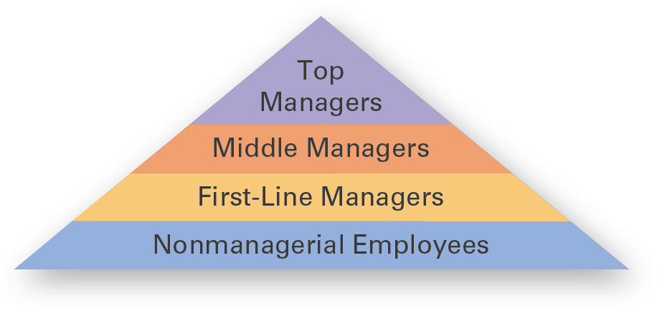
Exhibit 1-1: Levels of Management
© Pearson Education Limited 2016

Slide 7
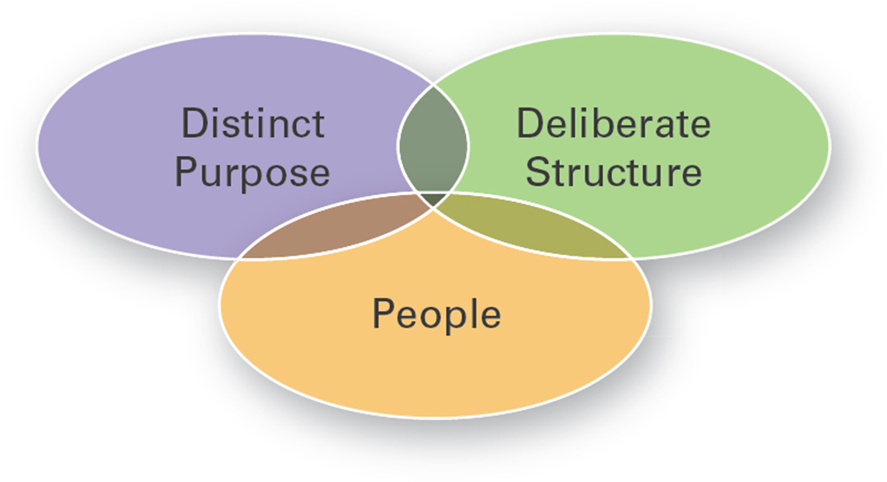
Where Do Managers Work?
Organization – A deliberate arrangement of people assembled to accomplish some specific purpose.
Common Characteristics of Organizations:
Have a distinct purpose (goal)
Are composed of people
Have a deliberate structure
© Pearson Education Limited 2016

Slide 8

What Do Managers Do?
Management – Coordinating and overseeing the work activities of others so their activities are completed efficiently and effectively.
It involves ensuring that work activities are completed efficiently and effectively by the people responsible for doing them.
© Pearson Education Limited 2016

Slide 9
Efficiency and Effectiveness
Efficiency refers to getting the most output from the least amount of inputs or resources.
doing things right – that is, not wasting resources.
Effectiveness is doing those work activities that will result in achieving goals.
doing the right things
© Pearson Education Limited 2016

Slide 10
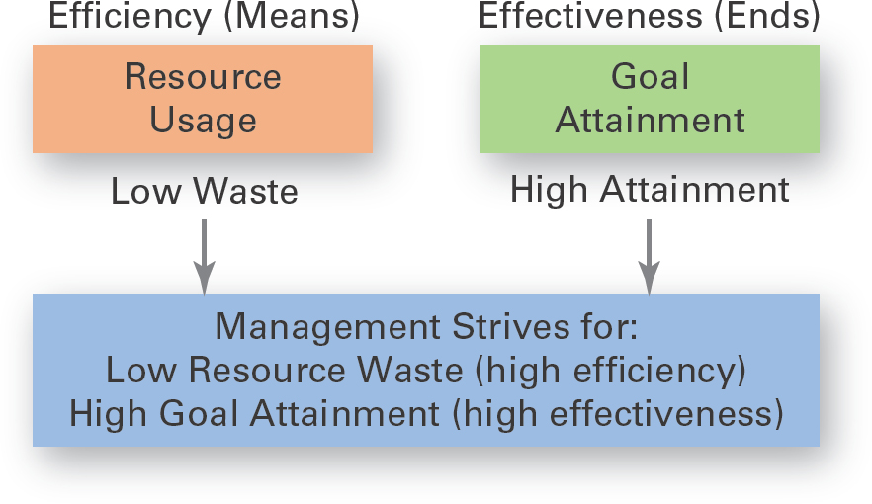
Exhibit 1-3 Efficiency and Effectiveness in Management
© Pearson Education Limited 2016

Slide 11
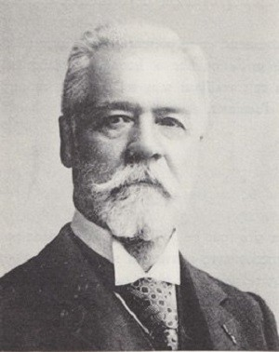
Management Functions
Managers perform certain activities or functions as they efficiently and effectively coordinate the work of others.
Henri Fayol, a French businessman suggested that all managers perform five functions:
Planning
Organizing
Commanding
Coordinating and
Controlling
© Pearson Education Limited 2016

Slide 12
Four Functions of Management
Planning – Defining goals, establishing strategies to achieve goals, and developing plans to integrate and coordinate activities.
Organizing – Arranging and structuring work to accomplish organizational goals.
Leading – Working with and through people to accomplish goals.
Controlling – Monitoring, comparing, and correcting work.
© Pearson Education Limited 2016

Slide 13
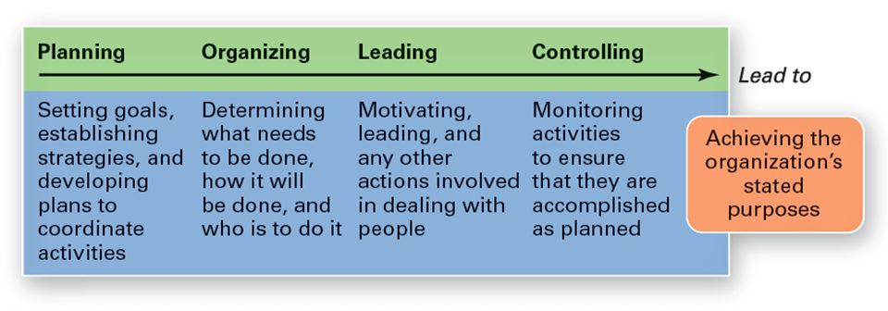
Exhibit 1-4 Four Functions of Management
© Pearson Education Limited 2016

Slide 14
Mintzberg’s Managerial Roles
Managerial roles – specific actions or behaviors expected of and exhibited by a manager.
Henry Mintzberg identified 10 roles grouped around interpersonal relationships, the transfer of information, and decision-making.
© Pearson Education Limited 2016

Slide 15
Mintzberg’s Managerial Roles
Interpersonal roles – cover the relationships that a manager has to have with others.
Figurehead, Leader, and Liaison
Informational roles – Collecting, receiving, and disseminating information.
Monitor, Disseminator, and Spokesperson
Decisional roles – making decisions or choices.
Entrepreneur, Disturbance Handler, Resource Allocator, And Negotiator
© Pearson Education Limited 2016

Slide 16
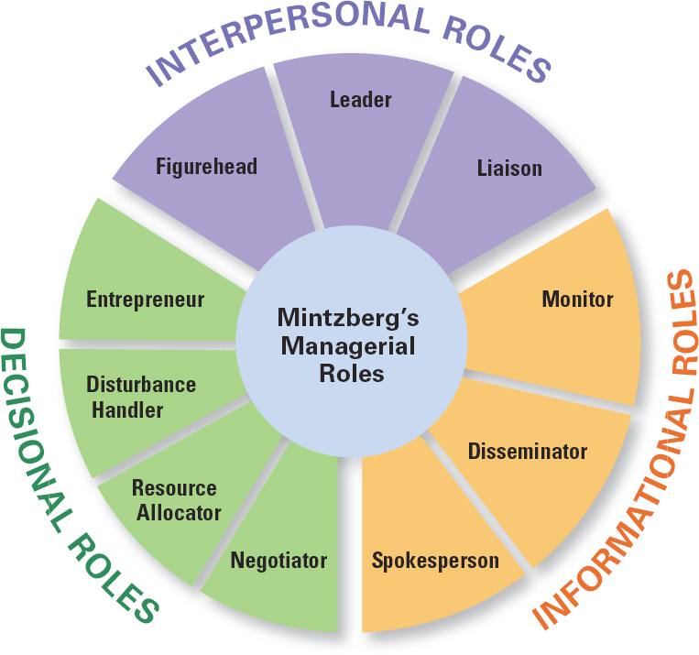
Exhibit 1-5 Mintzberg’s Managerial Roles
© Pearson Education Limited 2016

Slide 17
Management Skills
Robert L. Katz proposed that managers need three critical skills in managing:
Technical skills – job-specific knowledge and techniques needed to proficiently perform work tasks.
Interpersonal skills – The ability to work well with other people individually and in a group.
Conceptual skills – The ability to think and to conceptualize about abstract and complex situations.
© Pearson Education Limited 2016

Slide 18
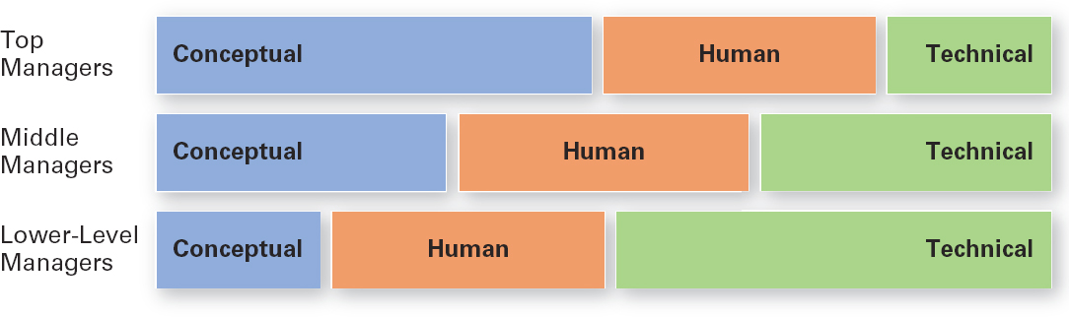
Exhibit 1-6 Skills Needed at Different Managerial Levels
© Pearson Education Limited 2016

Slide 19
How is the Manager’s Job Changing?
In today’s world, managers are dealing with global economic and political uncertainties, changing workplaces, ethical issues, security threats, and changing technology.
It’s likely that more managers will have to manage under such demanding circumstances, and the fact is that how managers manage is changing.
© Pearson Education Limited 2016

Slide 20
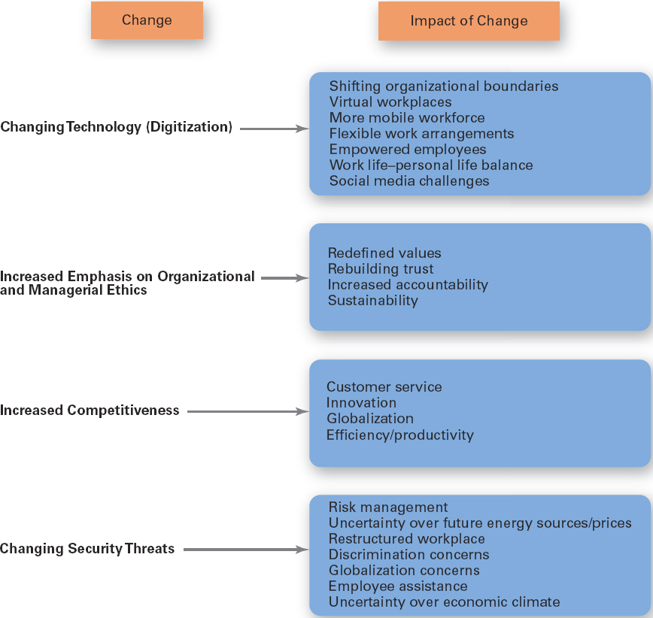
Exhibit 1-8 Changes Facing Managers
© Pearson Education Limited 2016

Slide 21

The Importance of Customers
Customers are the reason that organizations exist.
Managing customer relationships is the responsibility of all managers and employees. Employee attitudes and behaviors play a big role in customer satisfaction.
Consistent high quality customer service is essential for survival.
Managers must create a customer-responsive organization where employees are friendly and courteous, accessible, knowledgeable, prompt in responding to customer needs, and willing to do what’s necessary to please the customer.
© Pearson Education Limited 2016

Slide 22

The Importance of Social Media
Forms of electronic communication through which users create online communities to share ideas, information, personal messages, and other content.
Managers need to understand and manage the power and peril of social media.
More and more businesses are turning to social media not just as a way to connect with customers, but also as a way to manage their human resources and tap into their innovation and talent.
© Pearson Education Limited 2016

Slide 23

The Importance of Innovation
Innovation means exploring new territory, taking risks, and doing things differently.
Innovation isn’t just for high-tech or other technologically sophisticated organizations. Innovative efforts can be found in all types of organizations.
It is critical throughout all levels and parts of a organization.
© Pearson Education Limited 2016

Slide 24

The Importance of Sustainability
Sustainability – A company’s ability to achieve its business goals and increase long-term shareholder value by integrating economic, environmental, and social opportunities into its business strategies.
© Pearson Education Limited 2016

Slide 25
Why Study Management?
The Universality of Management: the reality that management is needed
in all types and sizes of organizations
at all organizational levels
in all organizational areas
in all organizations, regardless of location
© Pearson Education Limited 2016

Slide 26
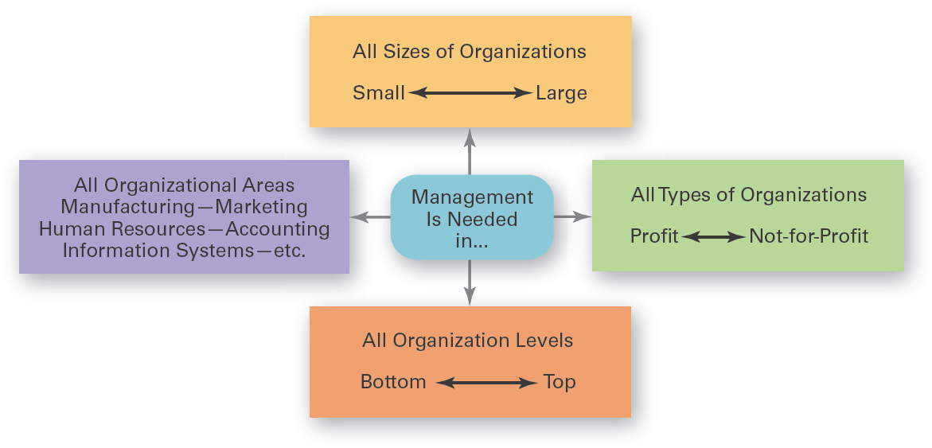
Exhibit 1-9 Universal Need for Management
© Pearson Education Limited 2016

Slide 27
The Reality of Work
You will either manage or be managed.
If you plan to be a manager, an understanding of management forms the foundation upon which to build your management knowledge and skills.
For those of you who don’t see yourself managing, you’re still likely to have to work with managers.
Also, assuming that you’ll have to work for a living and recognizing that you’re very likely to work in an organization, you’ll probably have some managerial responsibilities even if you’re not a manager.
© Pearson Education Limited 2016

Slide 28
Challenges of Being a Manager
Can be a tough and thankless job
May entail clerical type duties
Managers also spend significant amounts of time in meetings and dealing with interruptions
Managers often have to deal with a variety of personalities and have to make do with limited resources
Motivate workers in the face of uncertainty
© Pearson Education Limited 2016

Slide 29
Rewards of Being a Manager
Responsible for creating a productive work environment.
Recognition and status in your organization and in the community.
Attractive compensation in the form of salaries, bonuses, and stock options.
© Pearson Education Limited 2016

Slide 30
Exhibit 1-10 Rewards and Challenges of Being a Manager
Rewards | Challenges
Create a work environment in which organizational members can work to the best of their ability | Do hard work
Have opportunities to think creatively and use imagination | May have duties that are more clerical than managerial
Help others find meaning and fulfillment in work | Have to deal with a variety of personalities
Support, coach, and nurture others | Often have to make do with limited resources
Work with a variety of people | Motivate workers in chaotic and uncertain situations
Receive recognition and status in organization and community | Blend knowledge, skills, ambitions, and experiences of a diverse work group
Play a role in influencing organizational outcomes | Success depends on others’ work performance
Receive appropriate compensation in the form of salaries, bonuses, and stock options | blank
Good managers are needed by organizations | blank
© Pearson Education Limited 2016

Slide 31
Review Learning Objective 1.1
Explain why managers are important to organizations?
Organizations need their managerial skills and abilities in uncertain, complex, and chaotic times.
Managers are critical to getting things done in organizations.
Managers contribute to employee productivity and loyalty.
© Pearson Education Limited 2016

Slide 32
Review Learning Objective 1.2
Tell who managers are and where they work?
Managers coordinate and oversee the work of other people so that organizational goals can be accomplished.
Managers work in an organization, which is a deliberate arrangement of people to accomplish some specific purpose.
© Pearson Education Limited 2016

Slide 33
Review Learning Objective 1.3 (1 of 3)
Describe the functions, roles, and skills of managers?
Management involves coordinating and overseeing the efficient and effective completion of others’ work activities.
The four functions of management include planning, organizing, leading, and controlling.
© Pearson Education Limited 2016

Slide 34
Review Learning Objective 1.3 (2 of 3)
Mintzberg’s managerial roles include:
Interpersonal, involve people and other ceremonial/symbolic duties (figurehead, leader, and liaison).
Informational, collecting, receiving, and disseminating information (monitor, disseminator, and spokesperson).
Decisional, making choices (entrepreneur, disturbance handler, resource allocator, and negotiator).
© Pearson Education Limited 2016

Slide 35
Review Learning Objective 1.3 (3 of 3)
Katz’s managerial skills include:
Technical (job-specific knowledge and techniques)
Human (ability to work well with people)
Conceptual (ability to think and express ideas)
© Pearson Education Limited 2016

Slide 36
Review Learning Objective 1.4
Describe the factors that are reshaping and redefining the manager’s job.
Managers must be concerned with:
Customer service because employee attitudes and behaviors play a big role in customer satisfaction
Social media because these forms of communication are becoming important and valuable tools in managing
Innovation because it is important for organizations to be competitive
Sustainability as business goals are developed
© Pearson Education Limited 2016

Slide 37
Review Learning Objective 1.5
Explain the value of studying management.
The universality of management – Managers are needed in all types and sizes of organizations
The reality of work – You will manage or be managed
Significant rewards and challenges
© Pearson Education Limited 2016

